Slide 1

Library Management System
Submitted To – Mr. Anand Sehgal
Group Members-
Tanishq (22CSU451)
Shubham (22CSU444)
Kavi Wadhwa (22CSU467)
Tushar (22CSU452)

Slide 2
Library Management System
Welcome to our presentation on Library Management System, where we explore how MySQL , JDBC , and HTML can make your make your management more convenient.

Slide 3

INTRODUCTION
1. Purpose of the presentation:-
Discover the potential of MySQL , JDBC , and HTML in enhancing Library Management System.
2. Background on Library Management System:-
Learn about the challenges and opportunities in managing Library Data more precisely and conveniently

Slide 4
MySQL for Library Management system
1. Overview of MySQL
Explore the key features and benefits of using MySQL as a database management system.
2. Importance of using MySQL for Library Management System
Using MySQL for a Library Management System (LMS) offers several advantages due to its relational database management system capabilities.

Slide 5
JDBC for Library Management system
1. Introduction to JDBC
Discover the power of JDBC as a technology for connecting Java applications with databases.
2. How JDBC is used in Library management system
JDBC is used in a Library Management System to facilitate Java-based connectivity between the application and the MySQL database, enabling seamless interaction for tasks such as book searches, user information retrieval, and transaction processing.

Slide 6
JSP for Library Management system
1. Introduction to JSP
it enables dynamic, server-side content generation, seamlessly integrating Java code with JSP to create a robust and interactive web application for efficient hotel management
2. Benefits of using JSP
JSP allows the creation of dynamic and interactive web pages, making it easier to generate content dynamically based on user inputs and database interactions in a Library Management System.

Slide 7
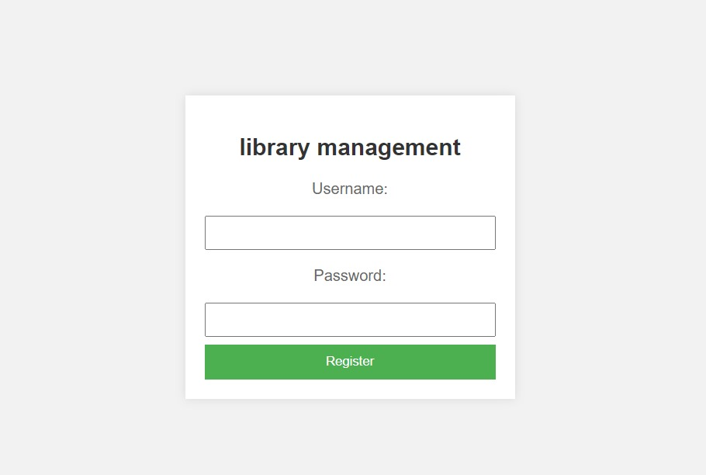
Registration Page

Slide 8
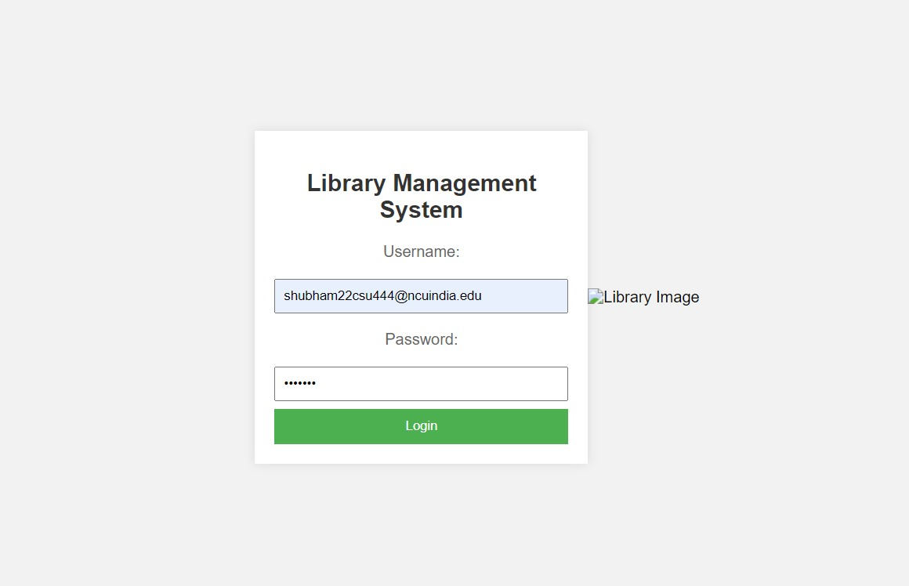
Login page

Slide 9
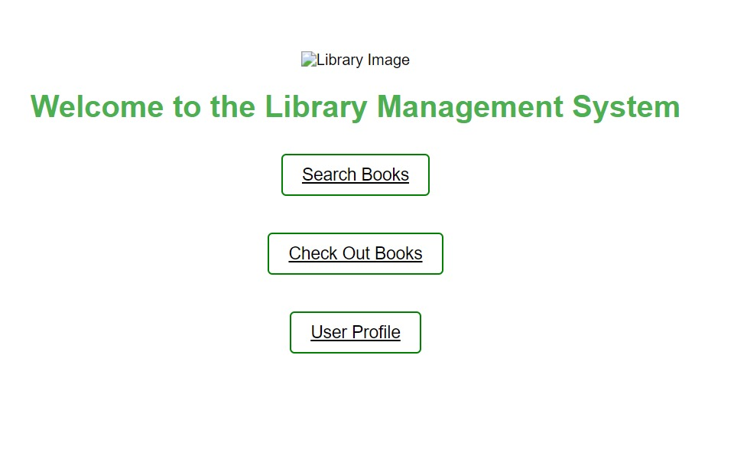
Home Page

Slide 10
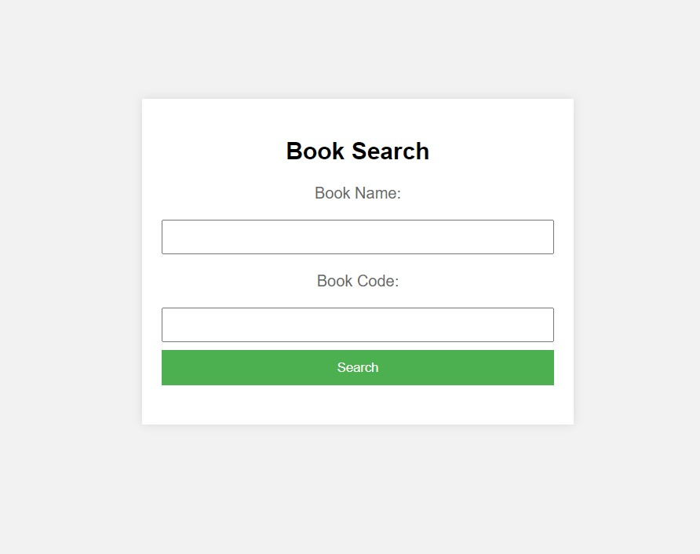
Search Option

Slide 11
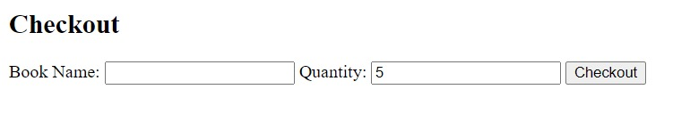
Check Out

Slide 12
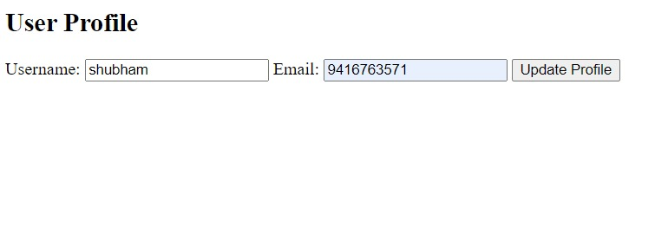
User Profile

Slide 13
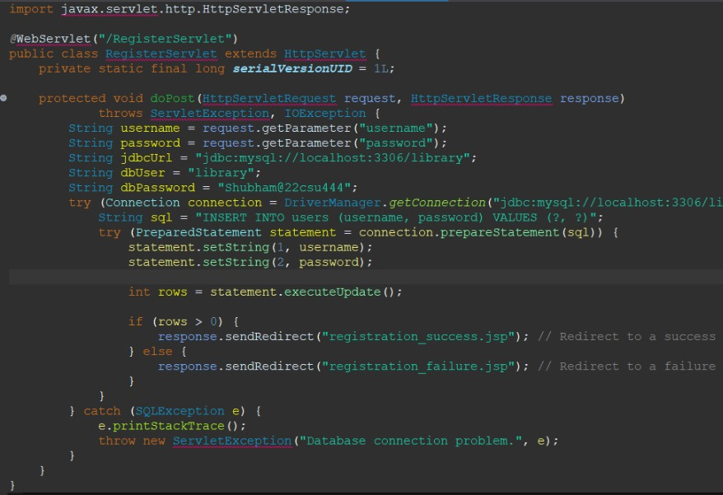
Registration servelet

Slide 14
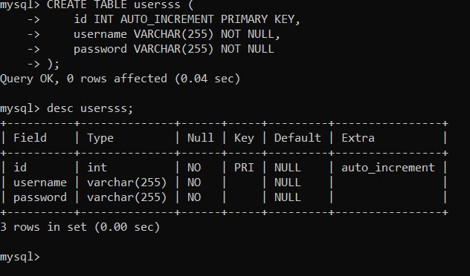
Database

Slide 15

Conclusion
In conclusion, the Library Management System project represents a comprehensive solution to streamline library operations, enhance user experiences, and ensure efficient information management.
Through the integration of modern technologies such as Java, MySQL, and JSP, we have successfully developed a robust and user-friendly system.

Slide 16
Thank you

